Slide 1
HOUSE PRICE PREDICTION
USING
MACHINE LEARNING ALGORITHMS

Slide 2
ABSTRACT
The accurate prediction of house prices is of paramount importance in real estate and property markets. In recent years, machine learning algorithms have emerged as powerful tools for addressing this challenge. .
The study begins by gathering a comprehensive dataset comprising a wide range of factors that influence house prices, such as location, size, number of bedrooms, bathrooms, amenities, and socio-economic indicators.
We have to implement the regression technique to predict the housing price such as Ridge and random forest regression. Finally, the experimental results shows that the error values, estimate the house price in Lakhs.

Slide 3
OBJECTIVES
The main objective of our project is,
To predict the house price based on different locations.
To implement the machine learning algorithm to find the mean error.
To enhance the overall performance for classification algorithms.

Slide 4
EXISTING SYSTEM
In existing, Predictive models for determining the sale price of houses in cities like Bengaluru is still remaining as more challenging and tricky task. The sale price of properties in cities like Bengaluru depends on a number of interdependent factors.
Key factors that might affect the price include area of the property, location of the property and its amenities. In this research work, an analytical study has been carried out by considering the data set that remains open to the public by illustrating the available housing properties in machine hackathon platform.
The data set has nine features. In this study, an attempt has been made to construct a predictive model for evaluating the price based on the factors that affect the price.
Modelling explorations apply some regression techniques such as multiple linear regression (Least Squares), Lasso and Ridge regression models, support vector regression, and boosting algorithms such as Extreme Gradient Boost Regression (XG Boost).

Slide 5
DISADVANTAGES
The results is sometimes unproven when compared with proposed statement
It doesn’t efficient for large volume of data’s .
Theoretical limits due to inaccurate information.

Slide 6
PROPOSED SYSTEM
In this system, the house dataset was taken as input from the dataset repository(KAGGLE,GITHUB). Then, we have to implement the data pre-processing step. In this step, we have to handle the missing values for avoid wrong prediction. Then, we have to split the data into test and train.
In this step, test is used for predict the model and train is used for evaluate the model.
We have to implement the machine learning regression algorithms such as Ridge and Random Forest Regression .
Finally, the experimental results shows that the performance metrics such as MAE(Mean Absolute Error) instead of Accuracy and predict the house price based on input attributes.

Slide 7
ADVANTAGES
It is the efficient method for large number of datasets.
The process is implemented with removing the unwanted data.
The prediction is efficient by using regression techniques.

Slide 8
FLOW DIAGRAM
Data set ( House dataset)
Input data
Handle missing value
Preprocessing
Label Encoding
Test
Drop unwanted columns
Data Splitting
Train
Classification
Random Forest Regressor
Ridge Regressor
MAE
Performance Analysis
Predict the house price

Slide 9
MODULES
Data selection
Data preprocessing
Data splitting
Classification
Result Generation

Slide 10
Modules description

Slide 11
DATA SELECTION
The input data was collected from dataset repository like UCI repository. In here, I used Kaggle.
In our process, house dataset is used.
The data selection is the process of predicting the house price.
The dataset contains the information about the house like location, area, square root, bed room, area type, availability, bath square feet and so on.,

Slide 12
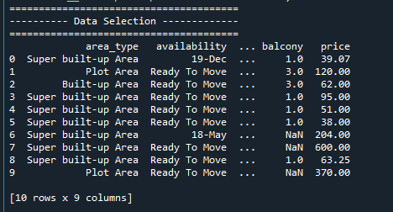
DATA SELECTION

Slide 13
DATA PREPROCESSING
Data pre-processing is the process of removing the unwanted data from the dataset.
Pre-processing data transformation operations are used to transform the dataset into a structure suitable for machine learning.
Missing data removal: In this process, the null values such as missing values and Nan values are replaced by 0.
Encoding Categorical data: That categorical data is defined as variables with a finite set of label values like 0,1,2,3...etc.,

Slide 14
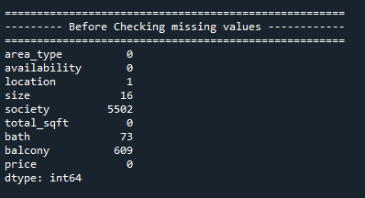
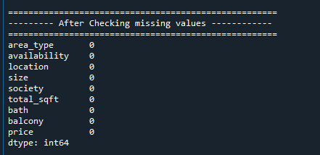
DATA PREPROCESSING

Slide 15
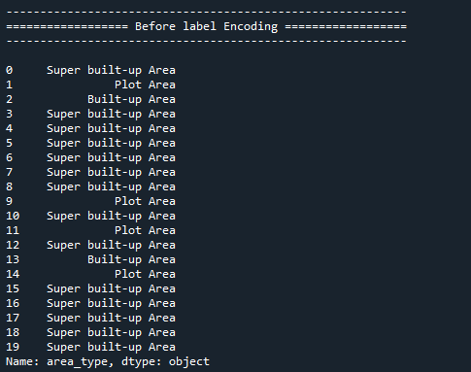
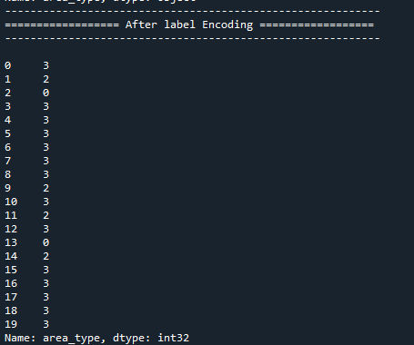
DATA PREPROCESSING

Slide 16
DATA SPLITTING
During the machine learning process, data are needed so that learning can take place.
In addition to the data required for training, test data are needed to evaluate the performance of the algorithm in order to see how well it works.
In our process, we considered 70%(9100+) of the our dataset to be the training data and the remaining 30%(3900+) to be the testing data of Total(13300+).
Data splitting is the act of partitioning available data into two portions, usually for cross-validator purposes.
One Portion of the data is used to develop a predictive model and the other to evaluate the model's performance.

Slide 17
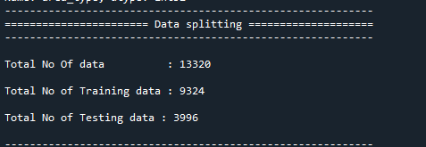
DATA SPLITTING

Slide 18
CLASSIFICATION
In our process, we have to implement the machine learning algorithms such as random forest regression and ridge regression.
Ridge regression is a model tuning method that is used to analyse any data that suffers from multicollinearity. This method performs L2 regularization. When the issue of multicollinearity occurs, least-squares are unbiased, and variances are large, this results in predicted values being far away from the actual values.
Random Forest Regression is a supervised learning algorithm that uses ensemble learning method for regression. Ensemble learning method is a technique that combines predictions from multiple machine learning algorithms to make a more accurate prediction than a single model.

Slide 19


CLASSIFICATION

Slide 20
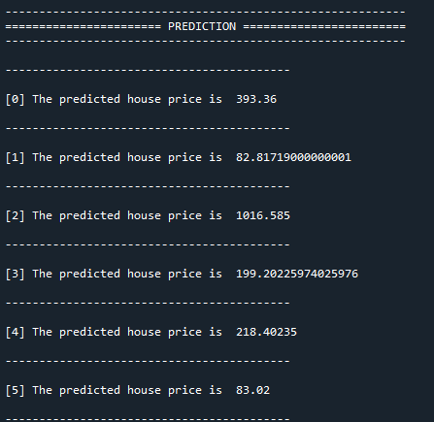
PREDICTION

Slide 21
PERFORMANCE
The Final Result will get generated based on the overall classification and prediction. The performance of this proposed approach is evaluated using some measures like,
MAE: In statistics, the mean absolute error (MAE) is a way to measure the accuracy of a given model. It is calculated as, MAE = (1/n) * Σ|y_{i} – x_{i}|
• Σ: A Greek symbol that means “sum”
• yi: The observed value for the ith observation
• xi: The predicted value for the ith observation
• n: The total number of observations

Slide 22
CONCLUSION
We conclude that, the house price dataset was taken as input. The input dataset was mentioned in our research paper.
We are implemented the different machine algorithm such as random forest regression and ridge regression.
Then, we are predicted the house price and performance metrics such as MAE.

Slide 23
REFERENCES
[1] Jiawei Han, MichelineKamber, “Data Mining Concepts and Techniques”, pp. 279-328, 2001.
[2] J. R.Quinlan,” Simplifying decision trees”, Int. J. HumanComputer Studies.
[3] Maria-Luiza Antonie, et. al., “Application of Data Mining Techniques for Medical Image Classification”, Proceedings of the Second International Workshop on multimedia Data Mining(MDM/KDD’2001) in conjunction with ACM SIGKDD conference. San Francisco,USA, August 26,2001.
[4] Nikita Patel and Saurabh Upadhyay, “Study of Various Decision Tree Pruning Methods with their Empirical Comparison in WEKA”, International Journal of Computer Applications, Volume 60– No.12, December 2012, pp 20-25.
[5] J.R. Quinlan, “C4.5: programs for Machine Learning”, Morgan Kaufmann, New York, 1993.

Slide 24
v2 — Model Comparison
Model | Params | R² (log, test) | MAE (log) | MAE (Lakh) | CV R² (log)
Linear Regression | — | 0.644 | 0.317 | 44.80 | 0.623
Ridge Regression | alpha = 0.1 | 0.644 | 0.317 | 44.80 | 0.623
Random Forest (best) | 200 trees, leaf >= 3 | 0.787 | 0.231 | 31.41 | 0.776
13,320 listings · 70/30 split (random state 2) · target = log(1 + price)
Random Forest explains ~79% of the (log) price variation; its 5-fold CV score matches the test score.
MAE (log) 0.231 = a typical prediction is within about a quarter of the actual price (multiplicatively).

Slide 25
v2 — Data Pipeline Improvements
• total_sqft is no longer dropped
• Parses text values, converts sq.meter / yards / acre / perch to sqft, ranges become their midpoint
• Removed 59 impossible rows (0.4%): 11 sqft flats, a 52,272 sqft house, 40-bathroom listings
• size -> BHK count; availability -> completion year (0 = ready to move)
• location / society frequency encoded (1,124 locations, ~2,600 societies) — no fake order, no 5,600 sparse columns
• Log-price target tames the right tail; linear models trained on standardized features
• Random Forest hyper-parameters chosen by 5-fold CV grid search (trees x leaf size)

Slide 26
v2 — Web App + REST API
• Two faces, one set of models
• Streamlit app: model switcher, all 1,124 locations, Data & EDA and Model Report pages
• FastAPI + custom single-page UI: one process, no build step, works offline
• REST endpoints
• POST /predict (any of the 3 models) · GET /models · /locations · /meta · /health · Swagger docs at /docs
• Deployment & quality
• Docker image (one command) · pytest test suite · GitHub Actions CI on every push

Slide 27
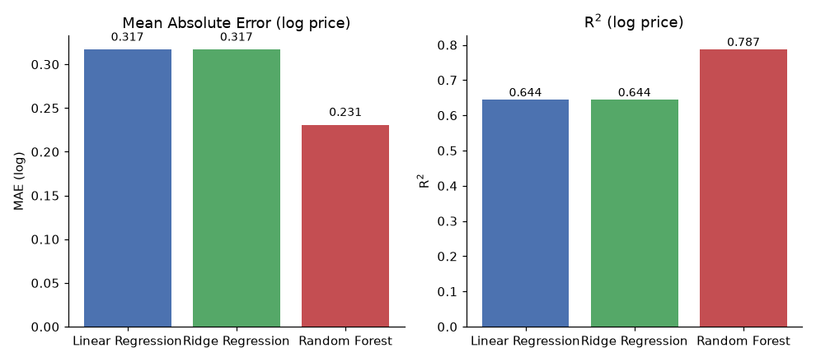
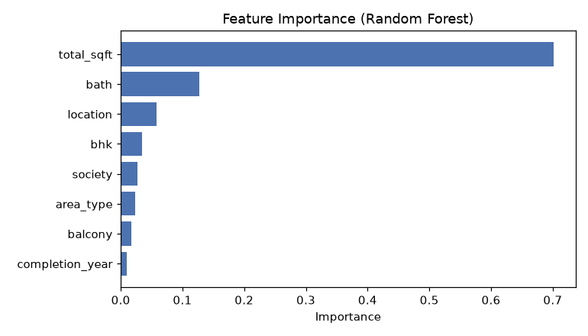
v2 — Model Diagnostics
Total area and BHK dominate the feature importance — what a human would expect. Location frequency captures how active a market is.

Slide 28
Thank You…

